Slide 1

Functional Programming In F#
Is it a fad?
Or absolutely fabulous!

Slide 2
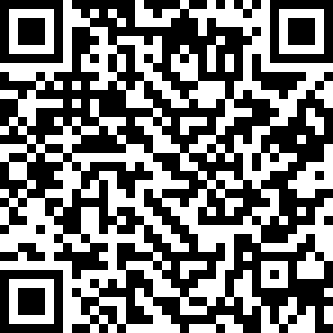
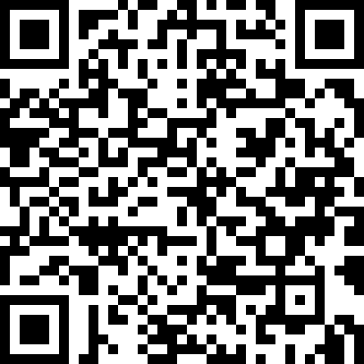
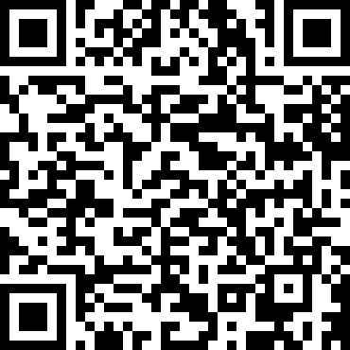
Who is Ken Bonny?
Freelance
Developer
team lead
analyst
architect
I blog at kenbonny.net
Follow me on Twitter @bonny_ken

Slide 3

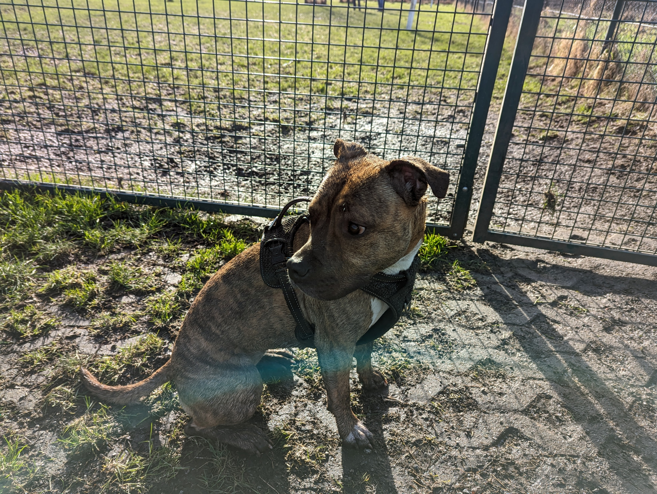
Dog person
Bad photographer

Slide 4
What am I talking about
The technology: F# and Wolverine
Functions & types
Piping
Computational expressions
Discriminated unions
Pattern matching
Testing
Message handling

Slide 5
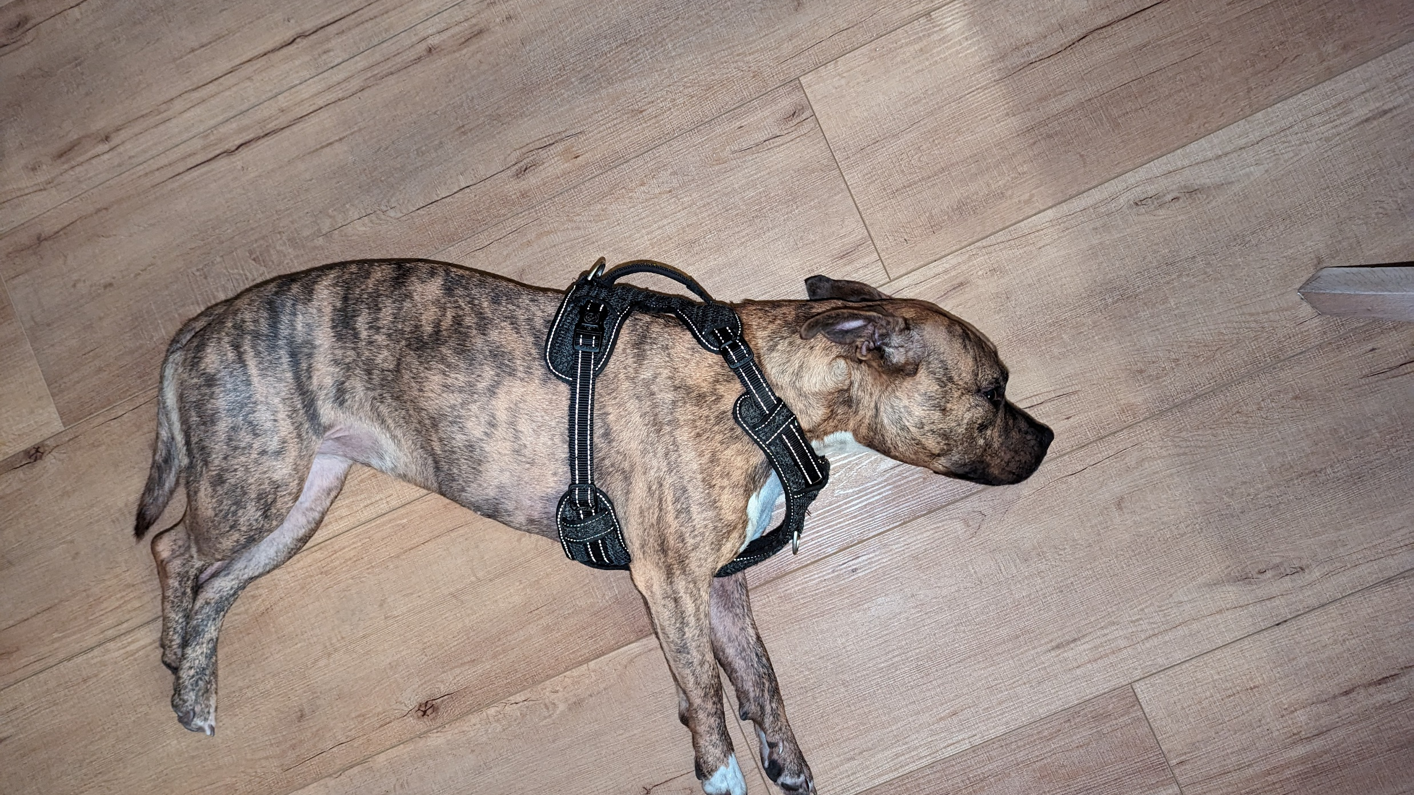
Notes:
Do not despair like my dog
Most of the terms I used sound scarier than they are
The most difficult one is computational expressions and that is only true when you want to create them
deprived of constant attention and cookies, kind of like facebook or twitter/x

Slide 6
Demo application
Drone flight tracking app
Overly simplistic, misses concepts
Nice showcase of what F# can do

Slide 7
The technology
F#
Functional first, OO second
Less boilerplate, concise
Dotnet ecosystem compatible
Scripting capabilities
Order is important!
Wolverine
Messaging first
Minimalistic, yet extendable
Reliable
Easy to understand
Convention over interfaces!

Slide 8
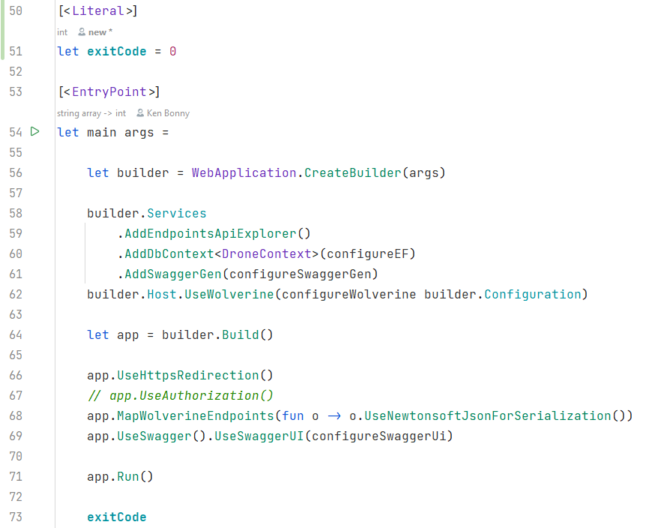
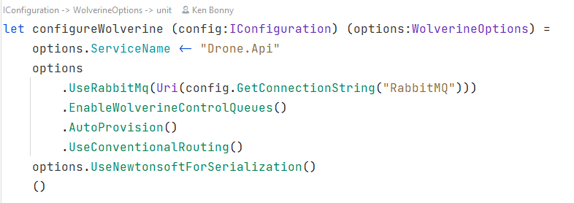
The API setup
Notes:
Order is important
Function and value creation with let
Partial application of a function
F# is full of nice little tricks like this

Slide 9
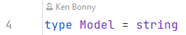
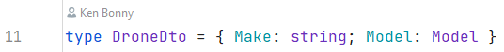
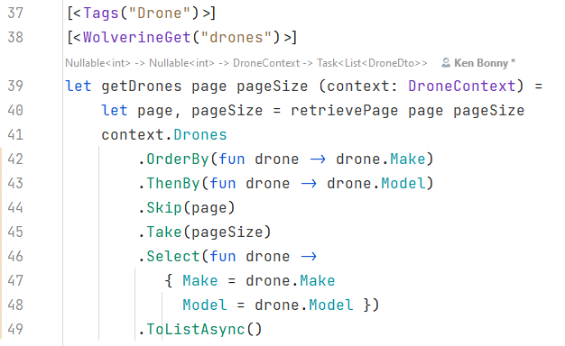
Retrieving a list of drones
Notes:
Model is a type alias, more descriptive than a regular string
Reassign page and pageSize values, not mutation!
Can be used in model binding and return values
Plays nice with entity framework
Wolverine specific attributes
- Tags for swagger grouping
- get for the path
Page + pageSize are query params
DroneContext is injected
Wolverine uses static functions and F# functions translate to those
Wolverine uses specific DI container called Lamar that allows this

Slide 10
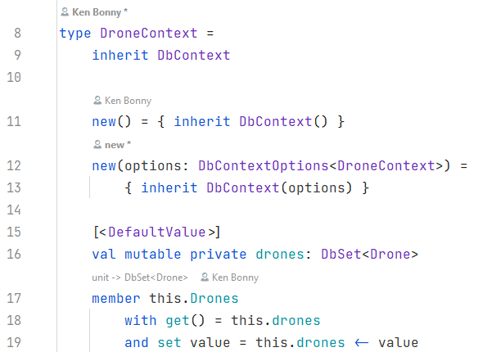
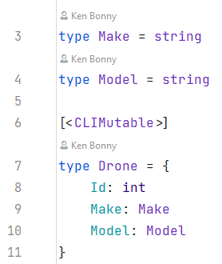
EF setup
Notes:
Pretty straightforward creation of a class
More code than auto properties from C#
Solved with a template
All table definitions need either mutable properties/fields
Or the entire type needs the [CLIMutable] attribute
This allows the runtime to modify the properties/fields, but in code the compiler will still treat it as immutable values

Slide 11
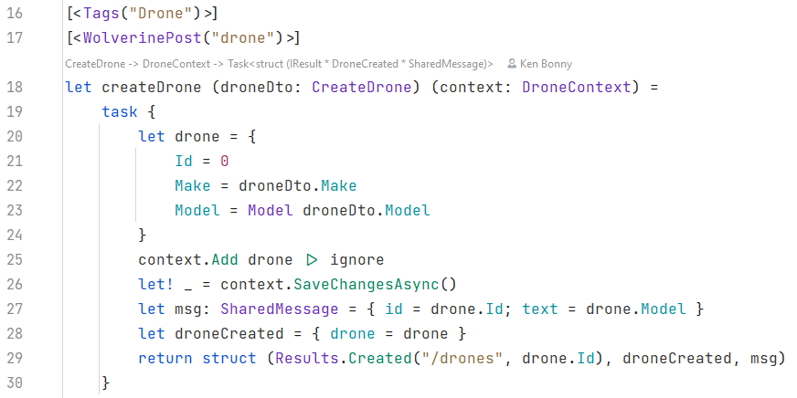
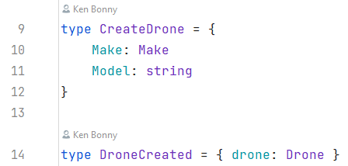
Creating a new drone
Notes:
Types and aliases, already familiar
The [CLIMutable] attribute is an EF necessity
CreateDrone is the DTO the endpoint will accept
DroneCreated is one of the messages we will send through Wolverine
The attribues will be familiar
The DTO will nicely be deserialised by the framework and the context injected
But now we get to something interesting: task {}
Called computational expression, used for all sorts of computations, this case: await
That is what the let! (pronounced let bang) does: in the context of the task, it acts as the await keyword in C#

Slide 12
Computational Expressions
Convenient syntax for writing computations that can be sequenced and combined using control flow constructs and bindings
In task context, let! or do! is equivalent to await in C#
Return values are specified with the return keyword
There is a return! keyword in most cases too
Notes:
That is what the let! (pronounced let bang) does: in the context of the task, it acts as the await keyword in C#

Slide 13
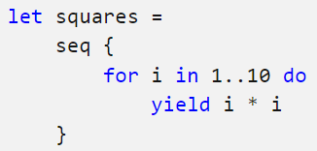
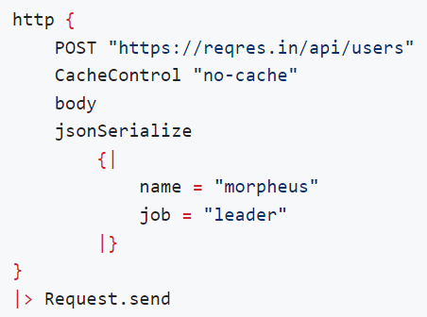
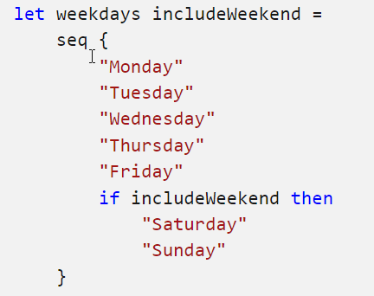
Examples
Seq
FsHttp
Notes:
Seq is the equivalent of Ienumerable
Can contain conditional logic
Can be used as a DSL (Domain Specific Language) such as for http requests

Slide 14
Creating a new drone
Notes:
Next to the computational expression, there is another interesting thing going on: the struct tuple

Slide 15
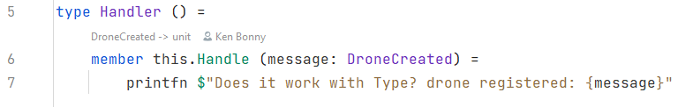
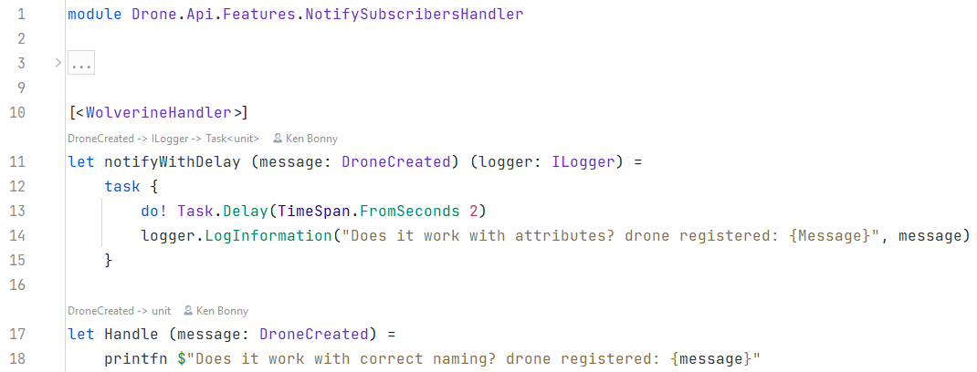
Background tasks
Notes:
3 types of handler registration
- type with Handler suffix and method named Handle
- module with Handler suffix and method named Handel
- module with Handler suffix and attribute WolverineHandler
Finding handlers is customisable!
First parameter is the message that is handled
Further parameters are injected using DI
Any return objects are treated as messages to send through the bus
Very MediatR like, but with the possibility to plug in a queue or enterprise bus
optional reliability settings such as message storage and retries

Slide 16

Notes:
If I read the room right, you all resemble my sceptical dog
I’ve shown several nice F# features
But nothing that can dethrone C# just yet
Let me present to you where F# shines

Slide 17
What is a flight
It’s a drone that will fly a certain route
I will ignore
Dates
Flight speed
Altitude
Focus on the data processing, not real-world complexity

Slide 18
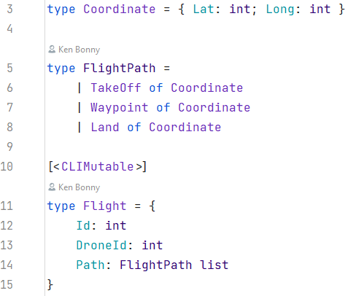
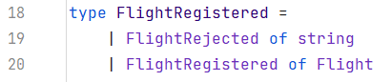
What is a flight
Notes:
Most important part here is the Discriminated Union that is named FlightPath and has 3 possible values: a place where it takes off, a place where it land and all waypoints in between

Slide 19
Discriminated Unions / Sum or Union Types
Values that can be one of several named cases
Each case can have its own type or value
Good for error cases or special values
Handle each case with pattern matching
Warning when not handling a case
Avoid catch all patterns

Slide 20
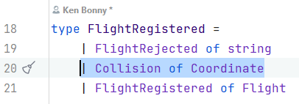
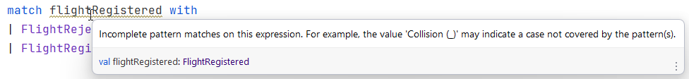
Discriminated Unions / Sum or Union Types
Notes:
When we add a case, the compiler will tell us where we need to update our code
It does this as a warning
I advise to treat them very seriously as this is a good indicator where bugs or missing feature are
Rider (and I assume Visual Studio too) have quick fixes to add the missing patterns

Slide 21
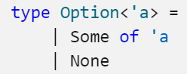
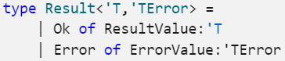
Famous examples
Option
Result
Equivalent Nullable<T>
Much safer
Used in algorithms

Slide 22
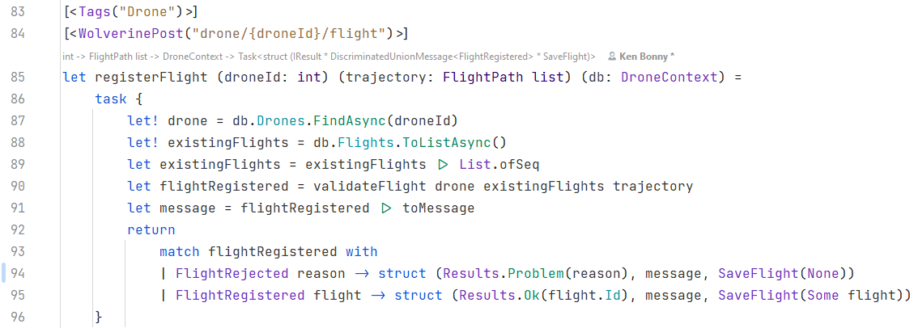
Register a flight
Notes:
Attributes, computational expressions and let! hold no more secrets
Below the return is a match statement as the validate flight returns a FlightRegistered DU
The match statement helps determine what we have to do in each scenario
Not much room for bugs or errors

Slide 23
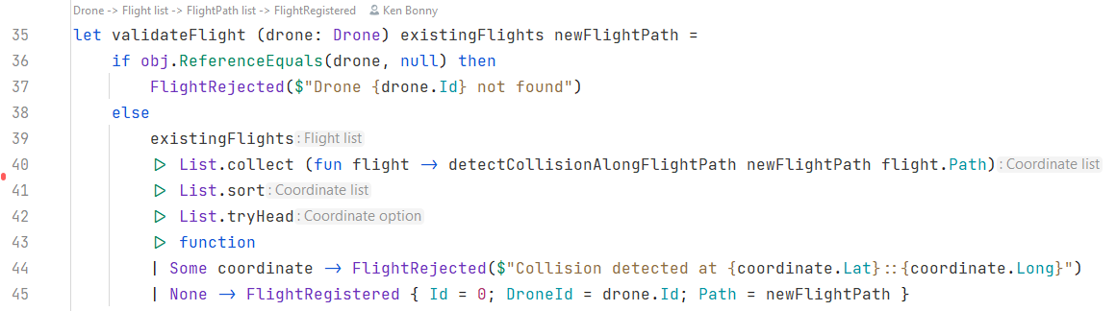
Validating the flight
Notes:
Wow, a lot is going on here, let’s unpack
Null check is a bit more complex as this is not normally done in F#
Normally, a Nullable<T> is returned which can be transformed into an Option and then pattern matched on that
The tryHead function at the bottom is an excellent example
it’s the FirstOrDefault Linq equivalent: empty list returns none, non-empty list returns the first item
Next is a function > this is a shorthand that crates a function with one parameter and automatically creates a pattern match
Could easily be written as such, but there is a shorthand as this is used a lot in F#

Slide 24
Piping
Piping enables function calls to be chained together as successive operations
The two lines are equivalent
Yet one reads more intuitively

Slide 25
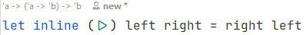
Who thinks |> is a keyword?
Notes:
It’s not!
It is a function, one that is supplied with the standard library, but it’s an ordinary function
Actually, it’s not that simple… it needs the inline keyword
I’ll let you look up what that keyword does (or you can come and ask me after the talk)
This is what you get when you do language design right, you get awesomely simple features like this from functionality available in the language, not baked into the language

Slide 26
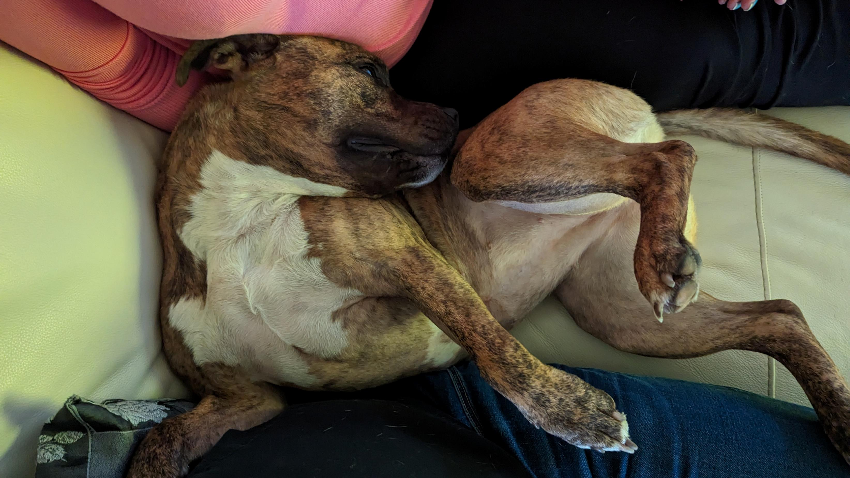
Notes:
When you see the implementation, you think it’s backwards
Left becomes right
But just like my dog, it’s weird and wonderful at the same time

Slide 27
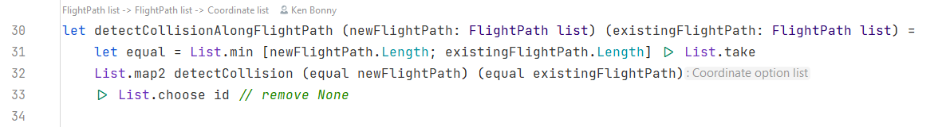
Validating the flight
Notes:
So null check is done, the function at the end is a shorthand match statement and we create a pipe that transforms the data
Lets take a closer look at that List.collect function
It transforms or maps (select in Linq), then takes the resulting list and flattens it into one long list (SelectMany in Linq)
The collision detection function in its turn first creates a function that will return the first x number of elements of a list
Here we see partial application at work again: we find the lower length and then supply the List.take function with that
All that now needs is a list to shorten
I did this, because the map2 function takes 2 lists of equal length and matches pairs
Should the flight paths have different length, there won’t be any errors
The List.choose takes in a function that returns an option and the choose function remove all None cases
The id function is a supplied method that just returns what it’s given

Slide 28
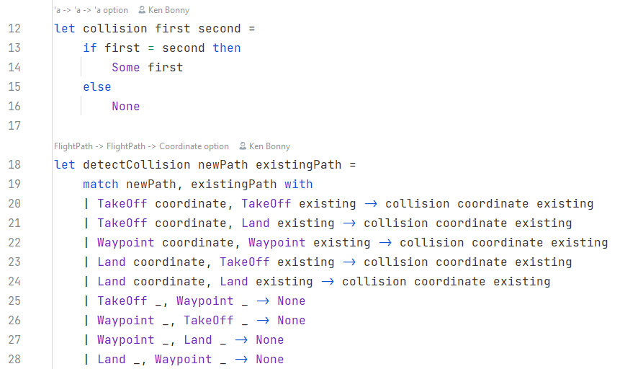
Detecting a collision
Notes:
Detecting a collision then becomes quite easy
The helper function can easily detect if they are the same, as records automatically implement value equality
The detectCollision on the other hand lists out every possible match between the two discriminated unions
Only during certain scenarios do we need to check for a collision
And all those scenarios are literally spelled out for us
Since all scenarios are spelled out, it’s quite difficult for a bug to hide in here
This is why F# is such a good language
Not saying that it’s easy and certainly not a lot of work
But less so than in a language where you can’t do this

Slide 29
With great power, come disadvantages
Not widely supported in serialisation
Newtonsoft.Json
No EF support
Custom value conversion
Wolverine message in local environment works fine
Wolverine message through a bus needs
Newtonsoft.Json as serialisation
Wrap the DU in a generic envelope
Notes:
Unfortunately, there are some drawbacks to Discriminated unions
Serialisation support is difficult: System.Text.Json (Microsoft’s out-of-the-box library for serialising to JSON) does not have support for DU’s
And as far as I know, is not planning on adding it
That is why I use Newtonsoft.Json
EF has no support for DU’s
They need custom value converters to save and load the data from a database
Sending DU’s through Wolverine works fine in a local scenario
When sending through a bus (Azure or RabbitMQ), it needs to use the Newtonsoft.Json serialisation
And wrapped in a generic envelope
This is because Wolverine looks for a method taking the specific DU case instead of a method taking the DU

Slide 30
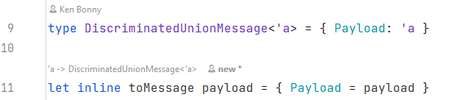
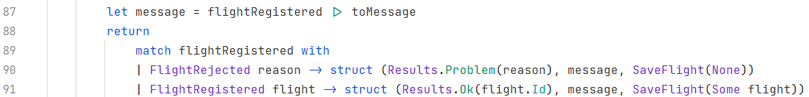
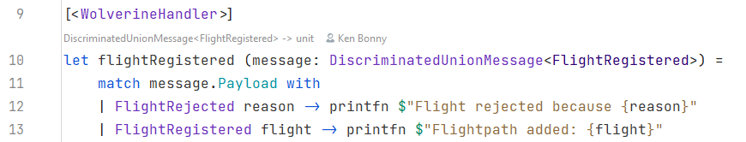
Register a flight
Notes:
The first 2 lines show what the envelope looks like
Together with a function to easily wrap any type into the envelope
On line 87, I wrap the message in a generic type so that it can nicely be routed to the correct handler methods
And then I send it through Wolverine to be routed to the handling message
The handling doesn’t do much in itself, but it shows that the message is received correctly

Slide 31
Register a flight
Notes:
Now for the last part of registering a flight… saving it to the database
For this, Wolverine has a feature called Side Effects: it requires a type that inherits a marker interface ISideEffect

Slide 32
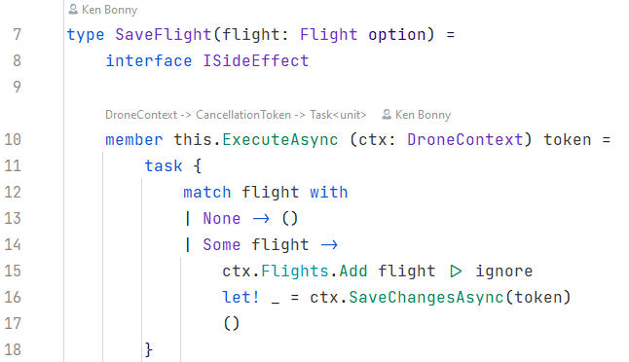
Saving a flight to the database
Notes:
This side effect lets the original function remain as pure as can be
It’s not 100% as it takes the DroneContext to load data, but it forgoes mutations to the database
These can be segmented away in special classes that take the data as injected parameters
And handle the side effect in an Execute or ExecuteAsync method in which services can be injected

Slide 33
Side Effects
Keep the original verification as pure as can be
Code to handle side effects remains simple
Testing the code that triggers a side effect is easier
Retries can be handled by Wolverine
Side effects can be routed through the bus
Notes:
The upside is that testing the original registration is easier (more on that in a minute)
The save logic can be very simple as this event only occurs when there is something to save
In case something goes wrong, retries can be built into Wolverine which rely on durable messaging
All side effects can be handled by a specialised server as this can be sent through the message bus

Slide 34
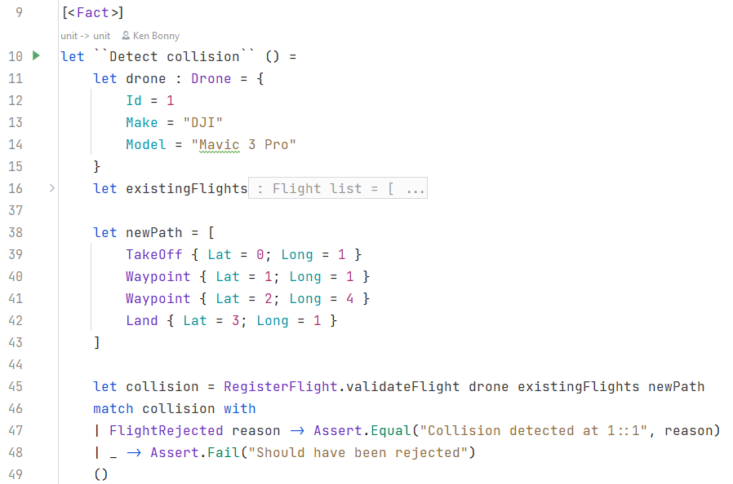
Testing it all
Notes:
For automated tests, I just use xUnit, set up data, feed it to the validation logic and discriminated unions make it easy to check what case I get back
Another little fun feature of F#, I can write function names between double backticks and make it a sentence
I wouldn’t use this for functions I would need to type a lot, because they always need to go between double brackets
But for tests this means no more snake or camel case

Slide 35
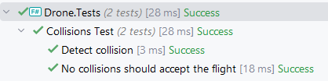
Testing it all

Slide 36
Architeture
F#
Wolverine
Elegant and readable
Separation between data and logic
Describe all possible states
Vertical slice architecture
Chaining events
Very composable
Load, process and save pattern

Slide 37
Summary
F#
Wolverine
Functions & types
Piping
Computational expressions
Discriminated unions
Pattern matching
Start with scripts
Easily create handlers
Separate side effects from logic
Vertical slice architecture
Simplify code with load, process and save pattern
Notes:
It goes a lot deeper
F# patten matching has only scratched the surface
Wolverine also has advanced features such as retries, error handling and sagas

Slide 38

Notes:
While I demoed this presentation to my wife, she mentioned that she could only envision Wolverine the X-Man and not the real animal slicing through a database
Had to do two things
- Hand in my geek card
- Use that as a Copilot prompt to see what it would create
Here we see Wolverine making vertical slice architecture happen

